Slide 1
INDUSTRIAL INTERNSHIP
Name : Ketan Jivan Badgujar
Enrollment no. : 12102110501009
Branch : CSE [IoT]

Slide 2
COMPANY PROFILE
Bharti Soft Tech Pvt Ltd is a global technology and process driven software solutions company offering customer centric solutions. With knowledge and experience of the entire IT lifecycle, we help enterprises streamline core IT processes and augment their competitive advantage. Our Agile tools and DevOps processes create outcome-based and ROI-driven solutions for technology teams and enterprises.

Slide 3
SERVICES PROVIDED BY THE COMPANY
APPLICATION SERVICES
PRODUCT ENGINEERING
DIGITAL TRANSFORMATION
5G TELECOM SERVICES

Slide 4
COLLABORATION
Headquartered in Switzerland, OrientSwiss, managed by an experienced team of e-commerce and fintech professionals, is delivering "Swiss Quality" service to merchants and shoppers alike in the fast-growing e-commerce mobile markets across the Middle East and Central Asia.
ZOODMALL : B2C Marketplace
ZOODPAY : Buy now, Pay later
ZOODSHIP : Logistics across border

Slide 5
MY ROLES AND RESPONSIBILITIES
Position : Intern
Employment Type : Internship
Domain : Machine Learning
Team : Bliznet
Team Guide : Mrs. Nimisha Vyas
Project : Product Specification Extraction Model & Blogger-A Blogging Website

Slide 6
PROJECT DESCRIPTION
The Modern Blog Management System is a full-stack web application designed to simplify the publishing, management, and reading of blog content. Built with Next.js, the application leverages React for a dynamic frontend experience and MongoDB for a flexible NoSQL data store. It provides a user-friendly interface for readers and an intuitive admin dashboard for content creators or administrators to manage blog entries.

Slide 7
TECHNOLOGY STACK USED FOR THE PROJECT
Frontend: Next.js (React 19), Tailwind CSS
Backend/API: Next.js API routes
Database: MongoDB with Mongoose ORM
Notifications: React Toastify
Other Tools: ESLint, PostCSS, Axios

Slide 8
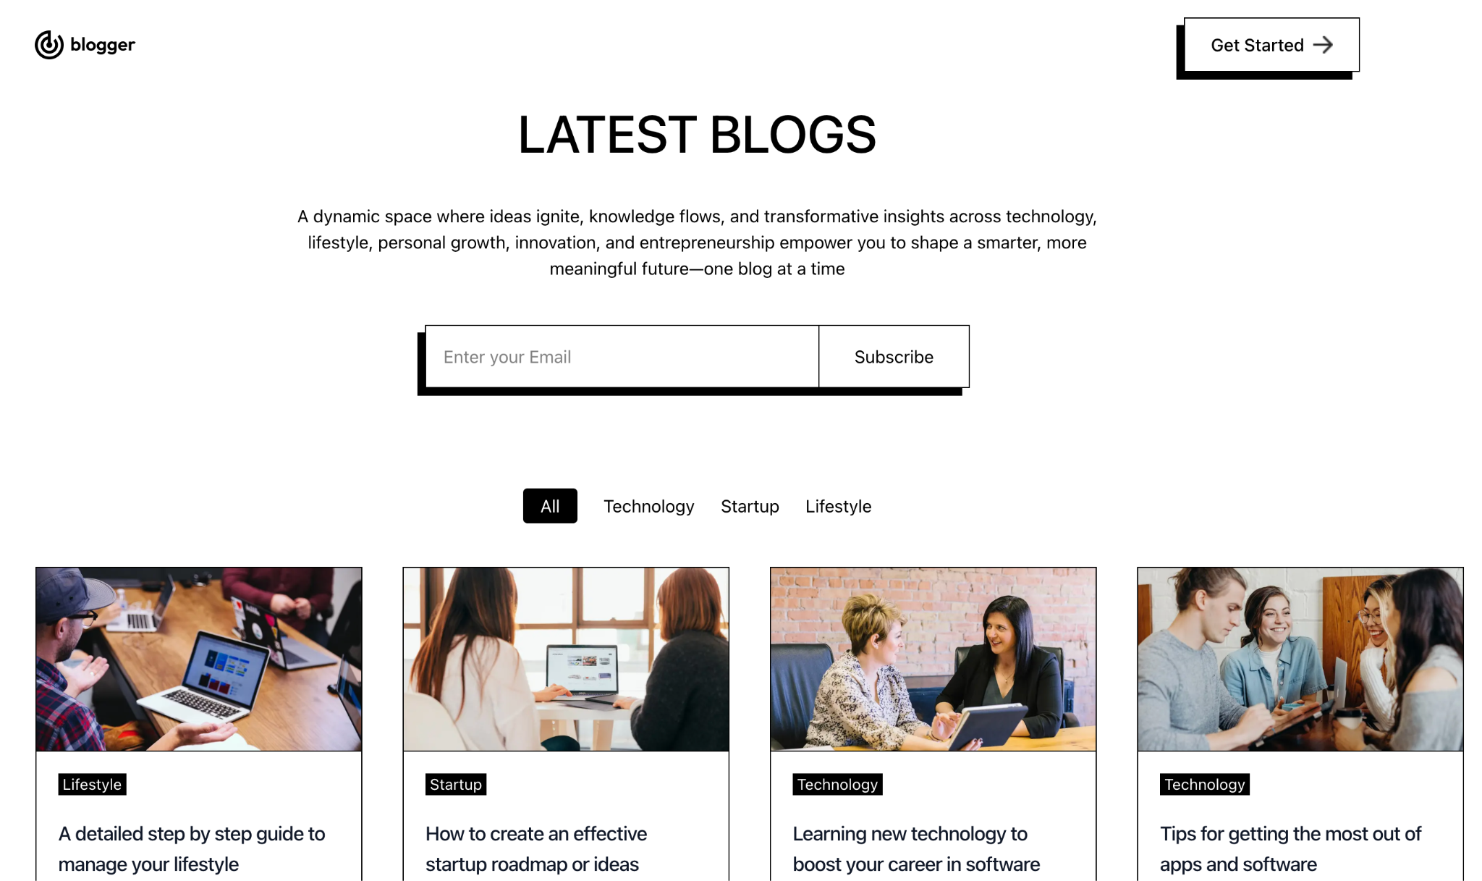
HOME PAGE

Slide 9
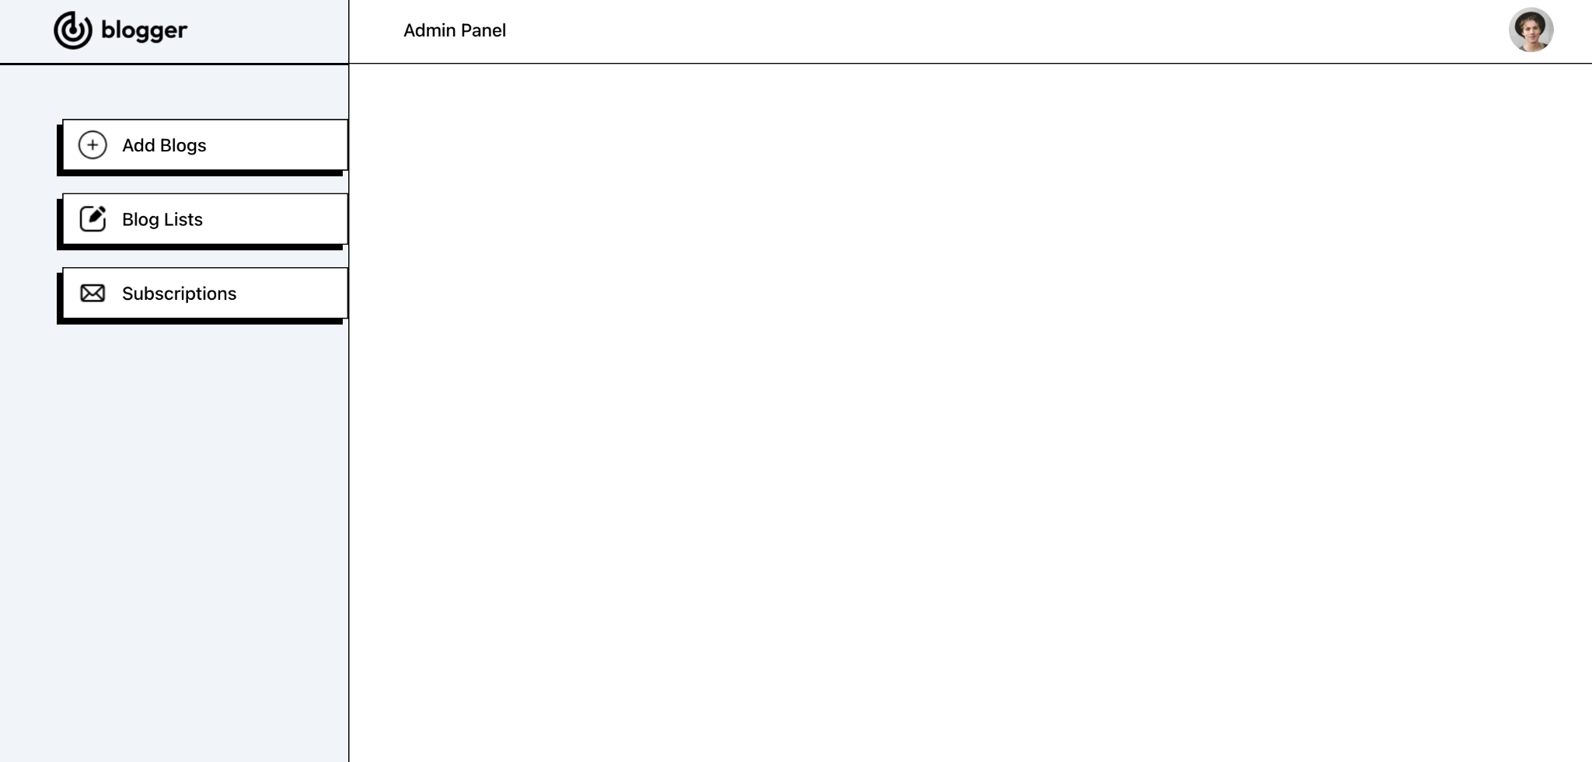
ADMIN PAGE

Slide 10
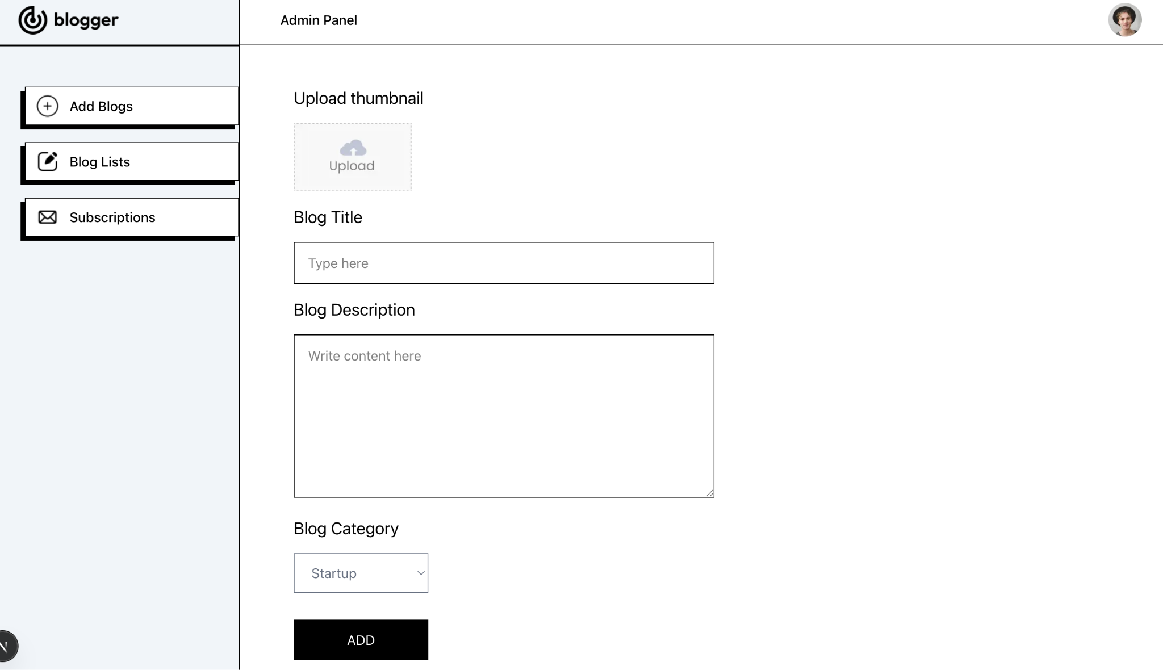
ADD BLOGS PAGE

Slide 11
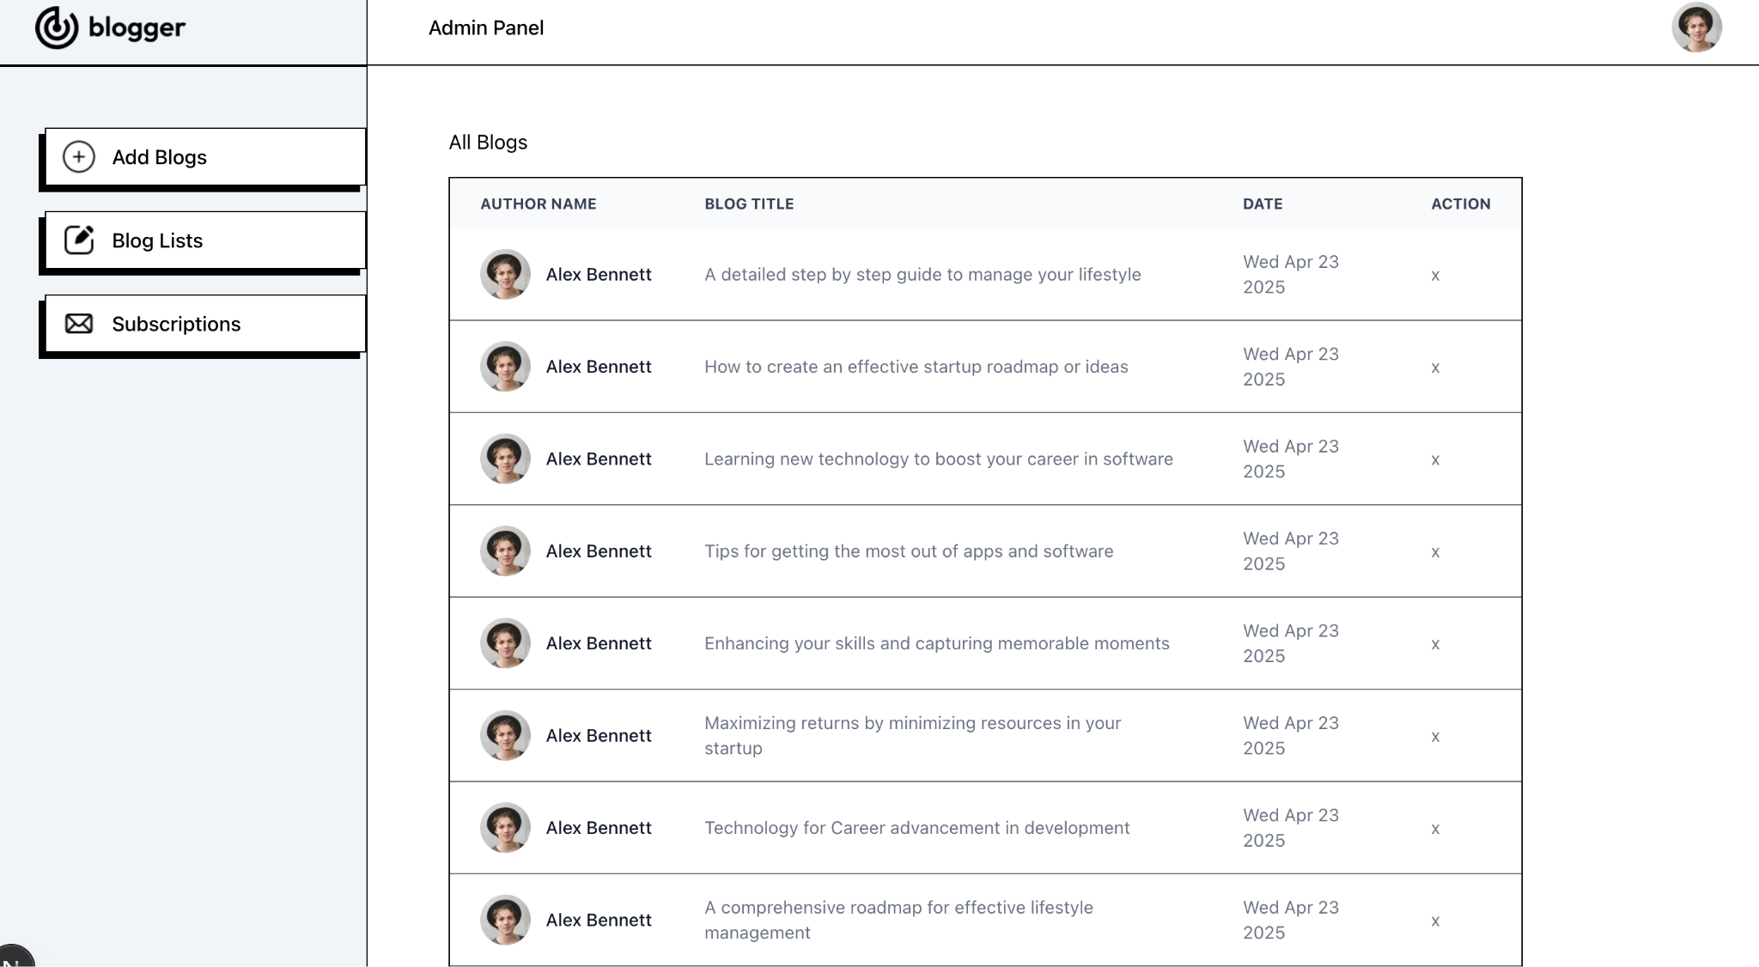
BLOG LIST PAGE

Slide 12
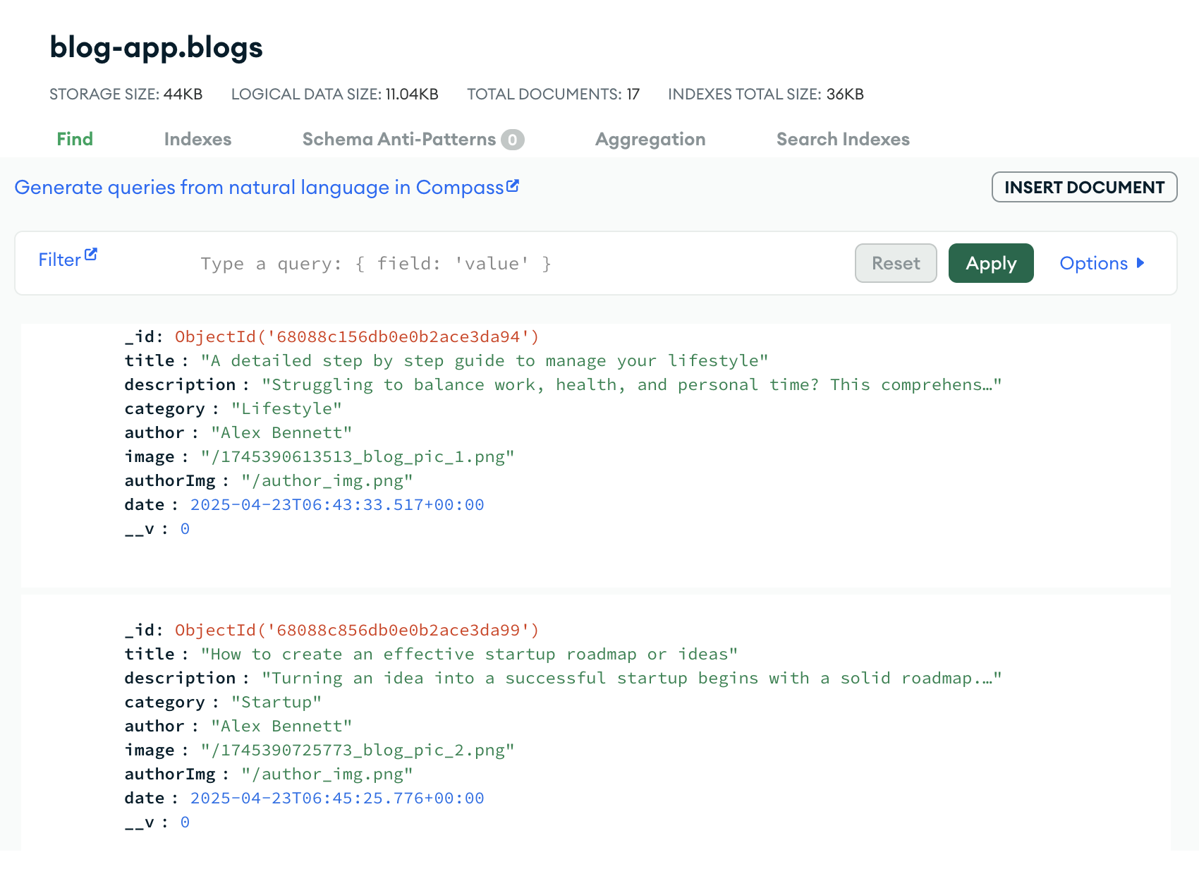
DATABASE

Slide 13
THANK YOU
Presented by : Ketan Badgujar

